Slide 1
Safety of Students In and Around Campus
Group-11
Nissim Panchpor
Shipra Gupta
Venessa Lobo

Slide 2
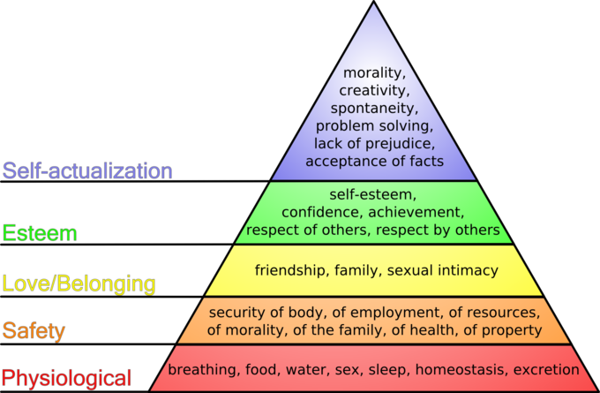


Slide 3
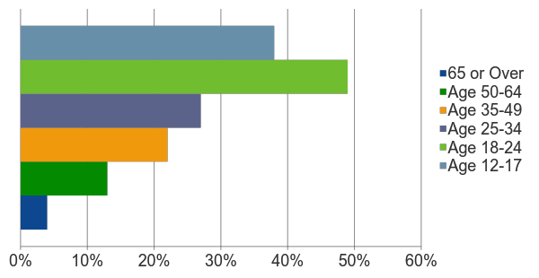
VICTIMS OF CRIME BY AGE
Students in the age group of 18-24 are far more likely to be victims of violent crime than other age groups (National Crime Prevention Council).
Notes:
Youths are far more likely to be victims of crime than other age groups.
Because far too many students experience or are exposed to violence, President Obama has proposed a comprehensive plan, Now is the Time, to protect schools and communities by reducing gun violence and providing resources to schools.
According to a 2011 report from the National Center for Education Statistics and the Bureau of Justice Statistics, 74 percent of public schools recorded one or more violent incidents of crime in the 2009-2010 academic year, and 23 percent of schools reported bullying among students on a daily or weekly basis.
The challenges that schools face in developing and maintaining safe, positive climates for learning are complex, but schools must remain safe havens in communities for students and their families.
SOURCE: Criminal Victimization, 2011; Bureau of Justice Statistics, http://www.bjs.gov/index.cfm?ty=tp&tid=31

Slide 4



Research Questions?
Degree of awareness regarding available security services
Uncertainty in utilizing the safety resources and factors behind it
Peer influence in using the security services

Slide 5
Research Method
Exploratory and Descriptive study
Quantitative Analysis – Survey Data
Qualitative Analysis – Interview Data
Surveys: Types of variables generated – nominal, ordinal and ratio
Interviews: A “narrative approach” - each participant’s stories and data as short précis

Slide 6


Instruments
Survey
Perspective of students regarding safety resources on a broader level
Identify safety topics that need more attention
5 minutes survey containing 16 questions
Personal Interviews
Semi-structured
Conducted 6 interviews with MSIM international students of 20-25 mins each
Gauge awareness and uncertainty
Recommendations

Slide 7
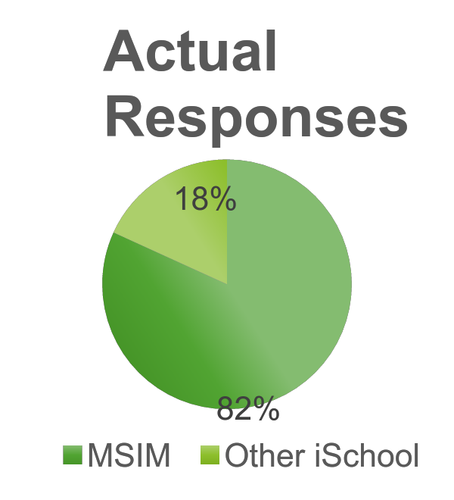





Instruments continued…
Sample Selection
Quota Sampling
Approached 45 iSchool students, target response rate of approx. 60%
70% MSIM students, 30% other iSchool students
Voluntary opt-in option for interviews
Ethical Considerations
Informed consent
Option to leave study at any point
Anonymity while collecting survey data
Secure destruction of the data after research completion
No anticipated risks

Slide 8
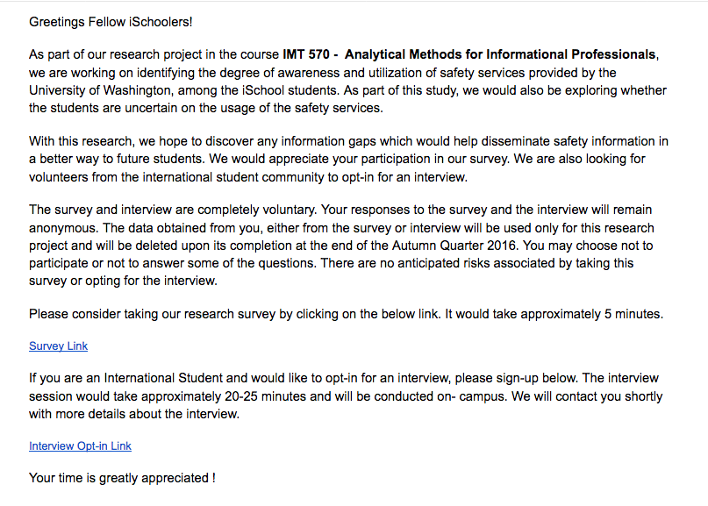
Survey Email Screenshot

Slide 9
Data Collection
First Instrument: Survey
Google Forms
Via Email
Reminders
Second Instrument: Interview
Audio Recording
Experience of Utilization of Services, Incidences, Recommendations
Key points as a précis

Slide 10
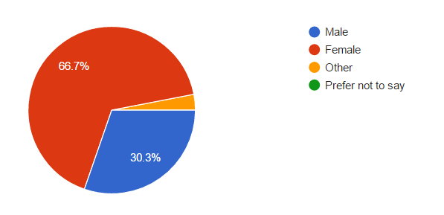
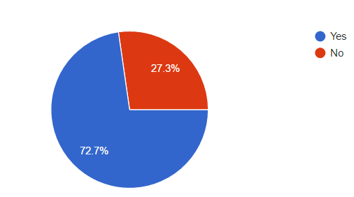
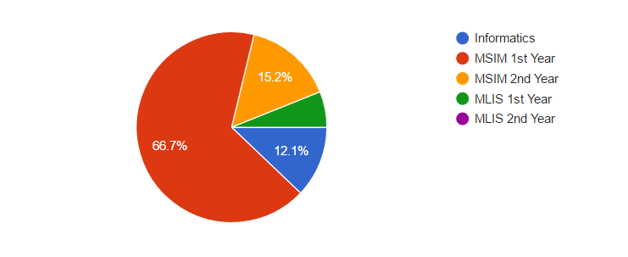
Response Statistics
Total 33 responses out of 45 = 73.33% Response Rate
Gender Distribution
iSchool Program
International Student?

Slide 11
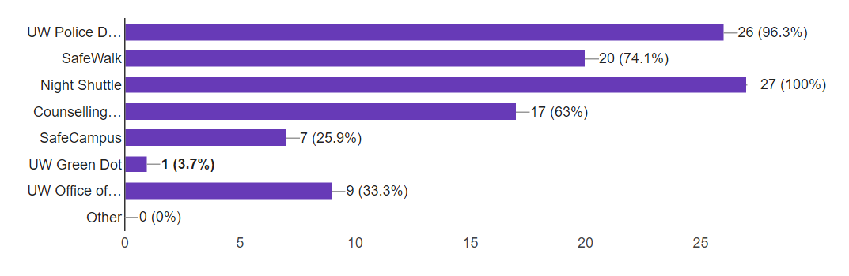
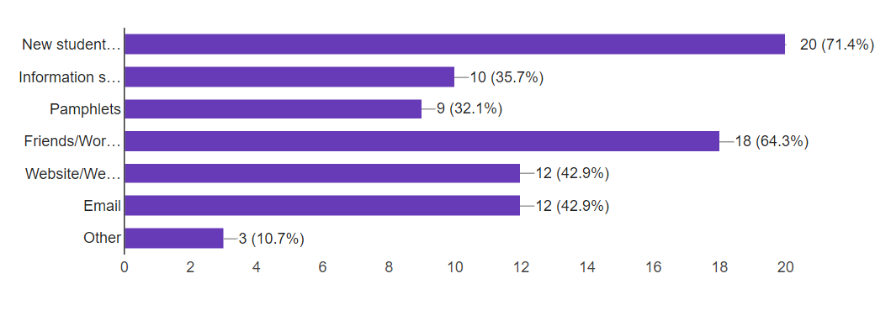
Response Statistics
UW Safety Services
Awareness Channels for the Safety Services

Slide 12
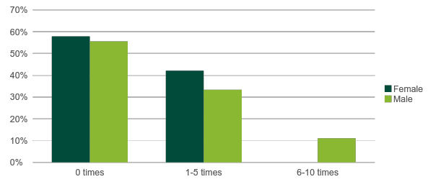
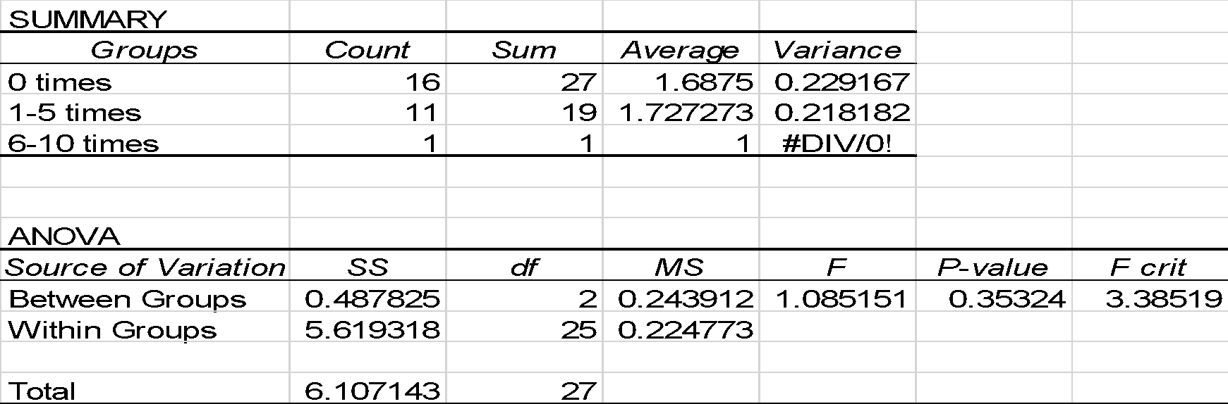
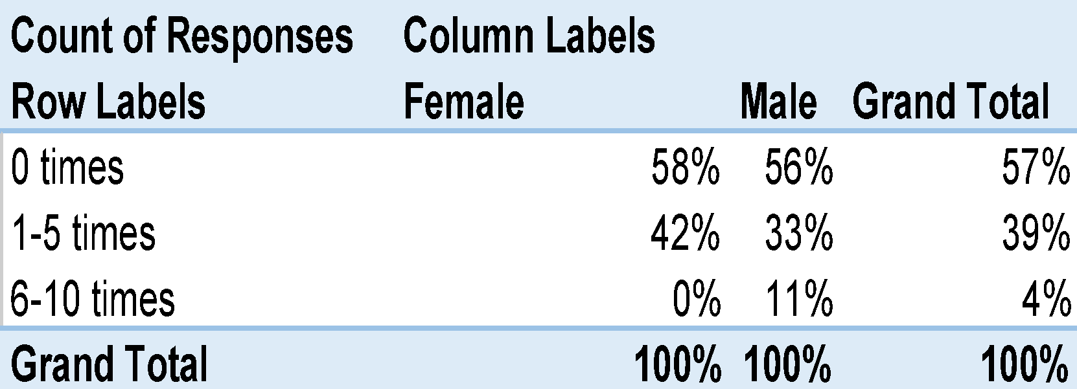
ANOVA between Gender and Frequency of Utilization
Null Hypothesis → The Gender of a participant has no association with the their Frequency of Utilization of the safety services.
Alternate Hypothesis → The Gender of a participant has an association with the their Frequency of Utilization of the safety services.
Gender
FreqOfUtil
Accept the Null Hypothesis

Slide 13
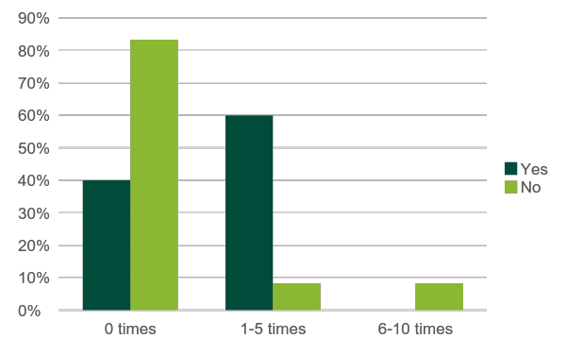
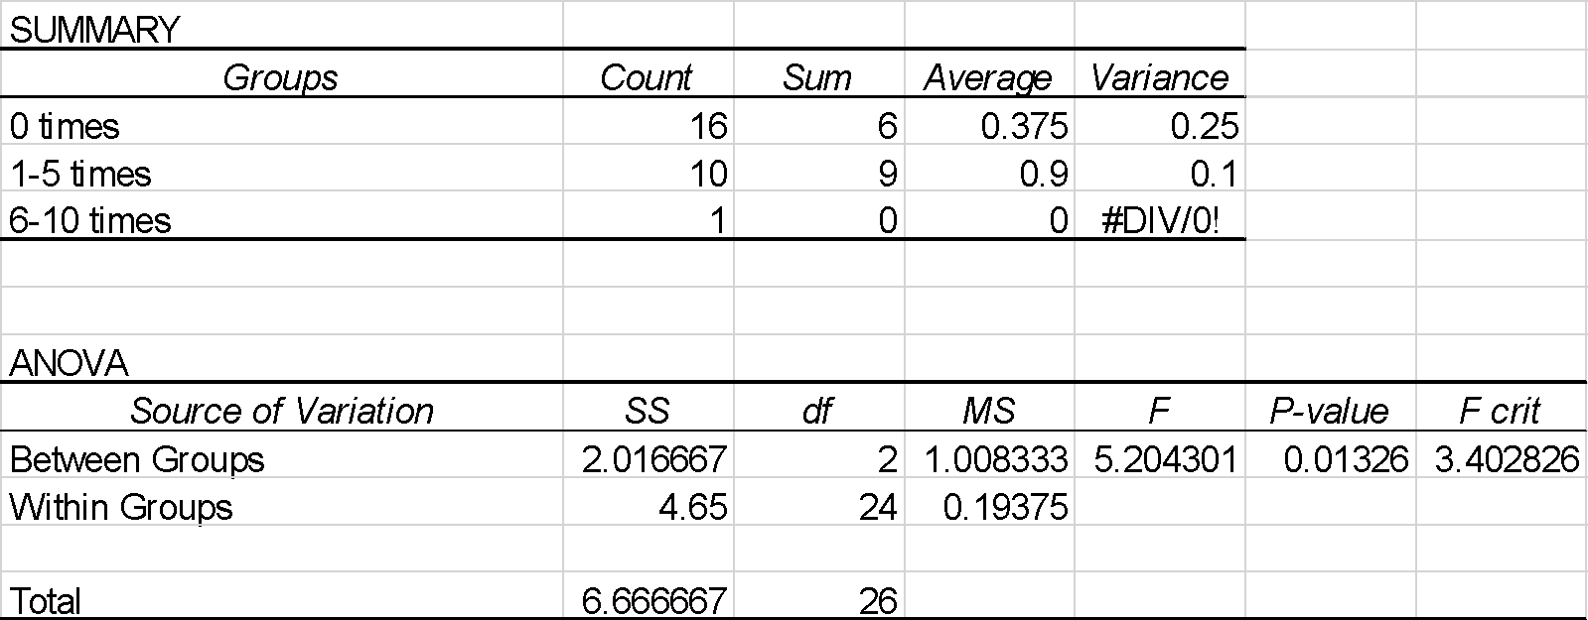
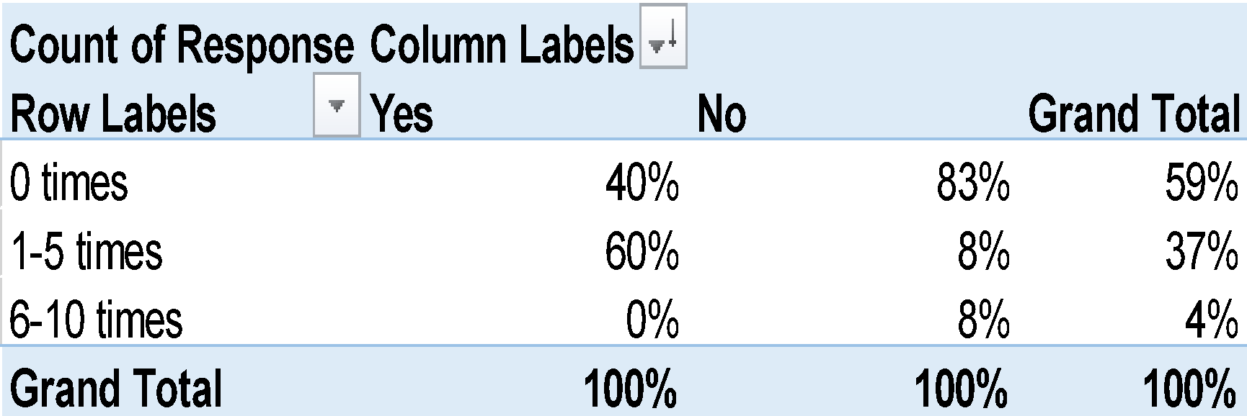
ANOVA between Peer Influence and Frequency of Utilization
Null Hypothesis → Peer Influence has no association with the Frequency of Utilization of the safety services.
Alternate Hypothesis → Peer Influence has an association with the Frequency of Utilization of the safety services.
PeerInfluence
FreqOfUtil
Reject the Null Hypothesis

Slide 14
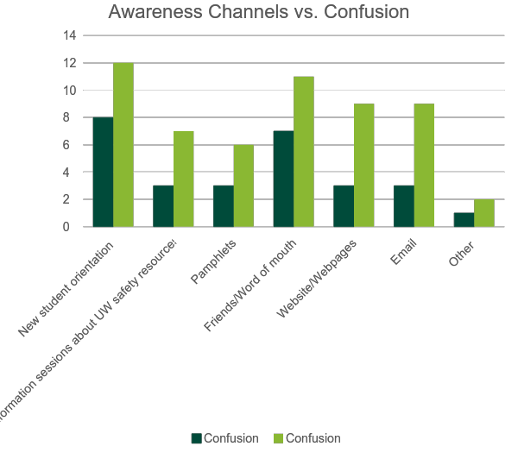
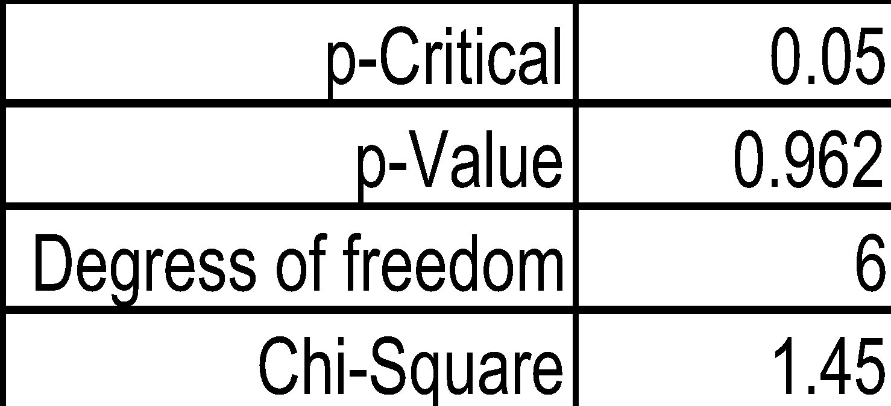
Correlation between Awareness Channels and Confusion
Null Hypothesis →
The Awareness Channels have no association with the Confusion level among students.
Alternate Hypothesis →The Awareness Channels have an association with the Confusion level among students.
Accept the NULL Hypothesis

Slide 15
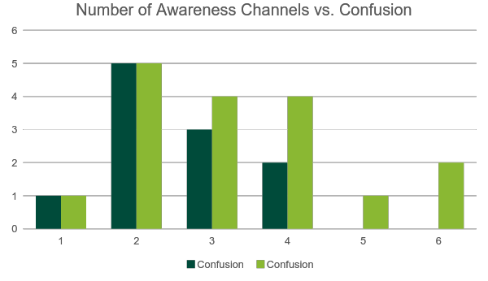
Correlation between Number of Awareness Channels and Confusion
No of Awareness Channels Known to Students | Confusion
 | Yes | No
0 | 4 | 0
1 | 1 | 1
2 | 5 | 5
3 | 3 | 4
4 | 2 | 4
5 | 0 | 1
6 | 0 | 2

Slide 16
Next Steps
The possible factors that act as a deterrent for students in making use of the safety facilities available to them.
Find practical ways that can be used to make students better informed about the resources and their rights.
Future Scope
Compare the utilization of the safety services between the domestic and international students.

Slide 17
Key Findings
Some students identified that there is a lack of effort on their part to learn more about the safety services
Provide mandatory orientation sessions with smaller groups of students
Sample drill for students to understand how to utilize the services
SafeWalk Officials need to be more flexible with pick-up points for students
Place contact information for the safety services at more locations in the campus

Slide 18

Thank you!

